Slide 1
Computer Organization & Assembly Language (CSC-205)
Lecture 4

Slide 2
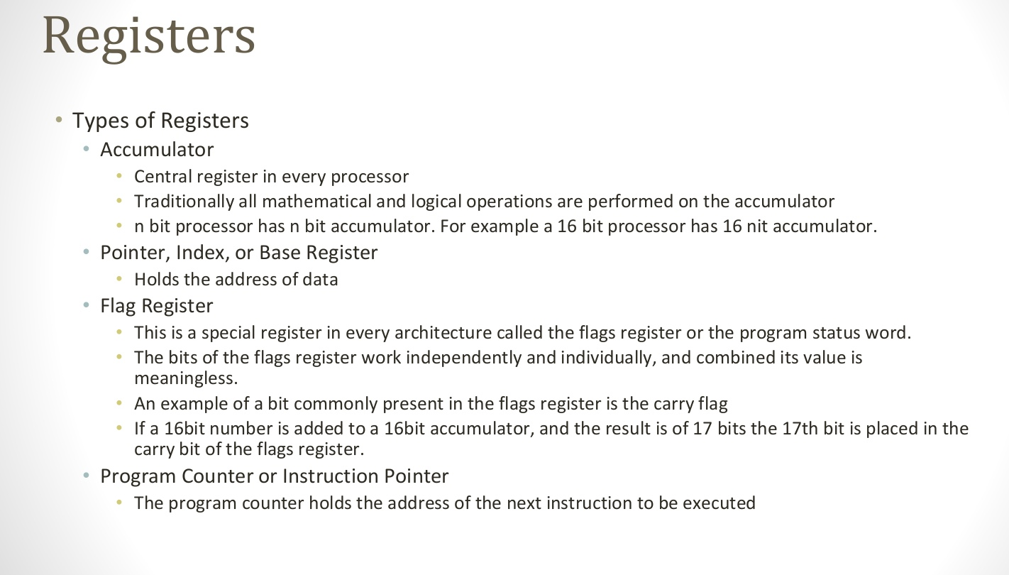
Registers

Slide 3
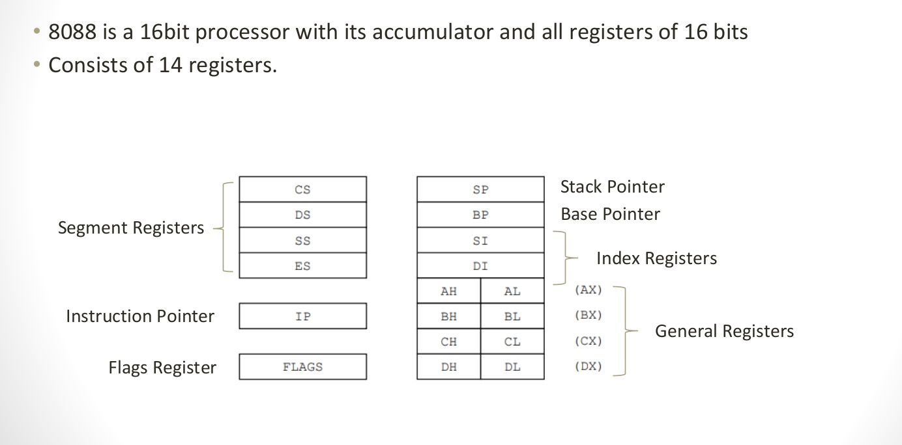
REGISTER ARCHITECTURE

Slide 4
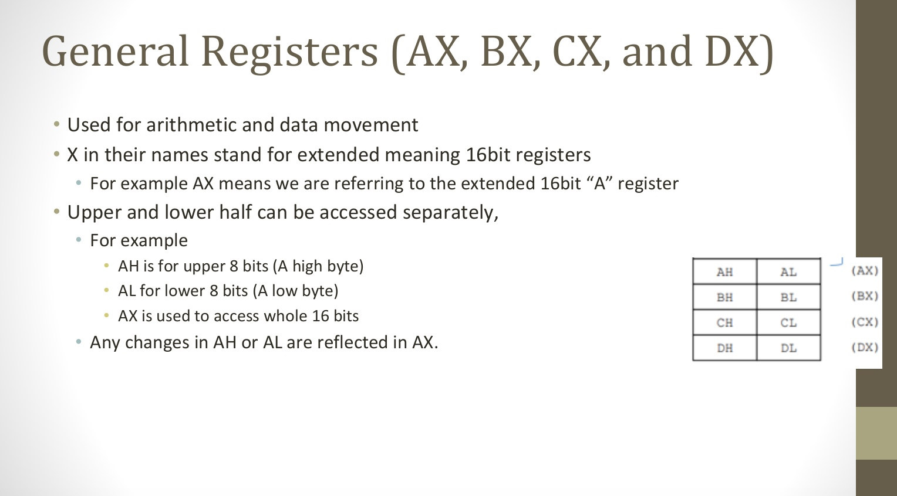
General Purpose Register
Notes:
ax(accumulator register), bx(base register),

Slide 5
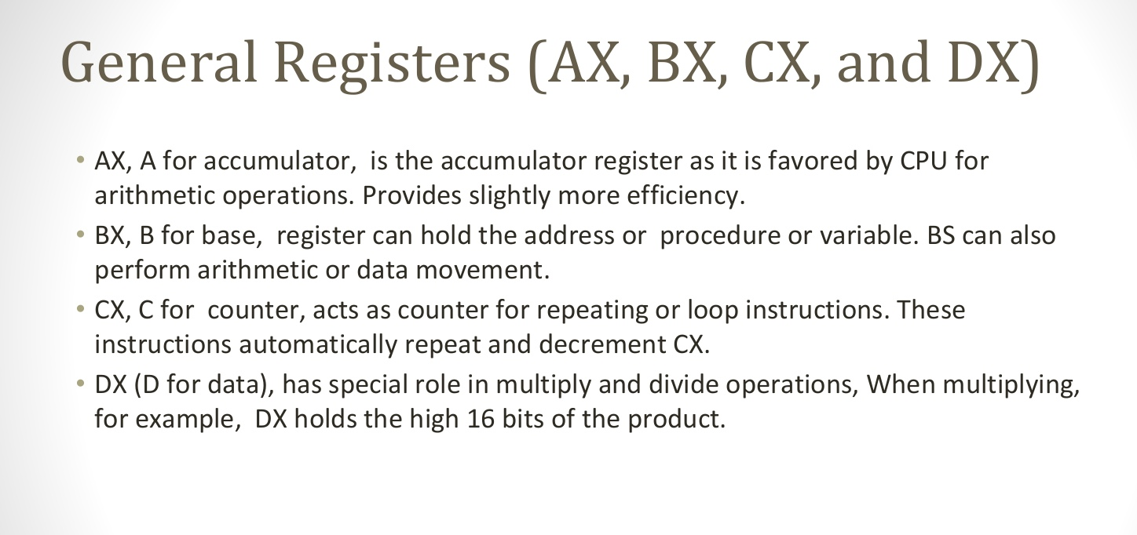
General Purpose Register

Slide 6
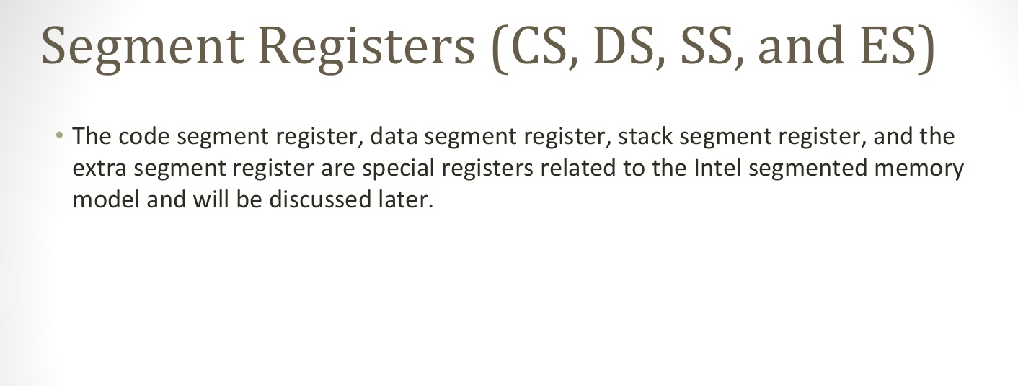
Segment Registers (CS, DS, SS, and ES)

Slide 7
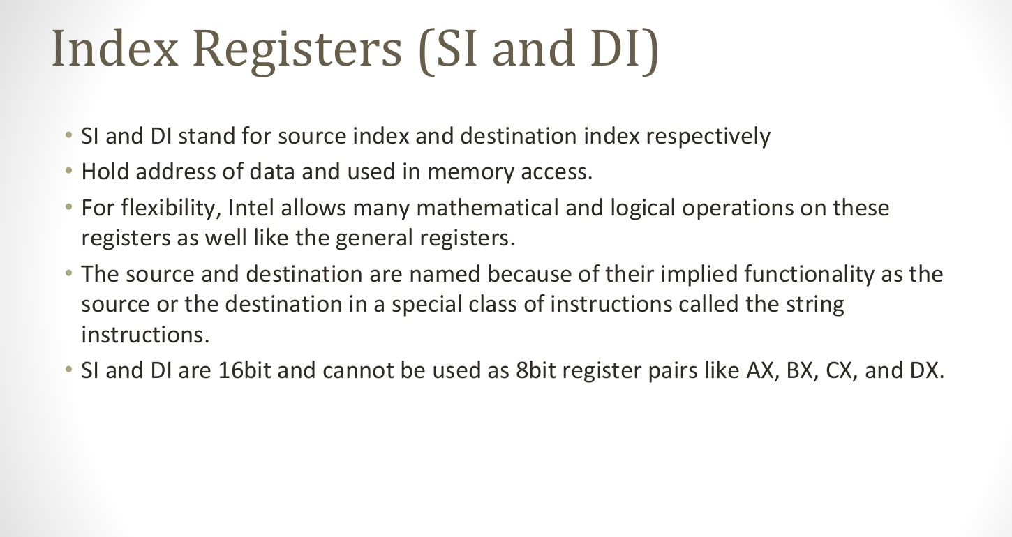
Index Registers

Slide 8
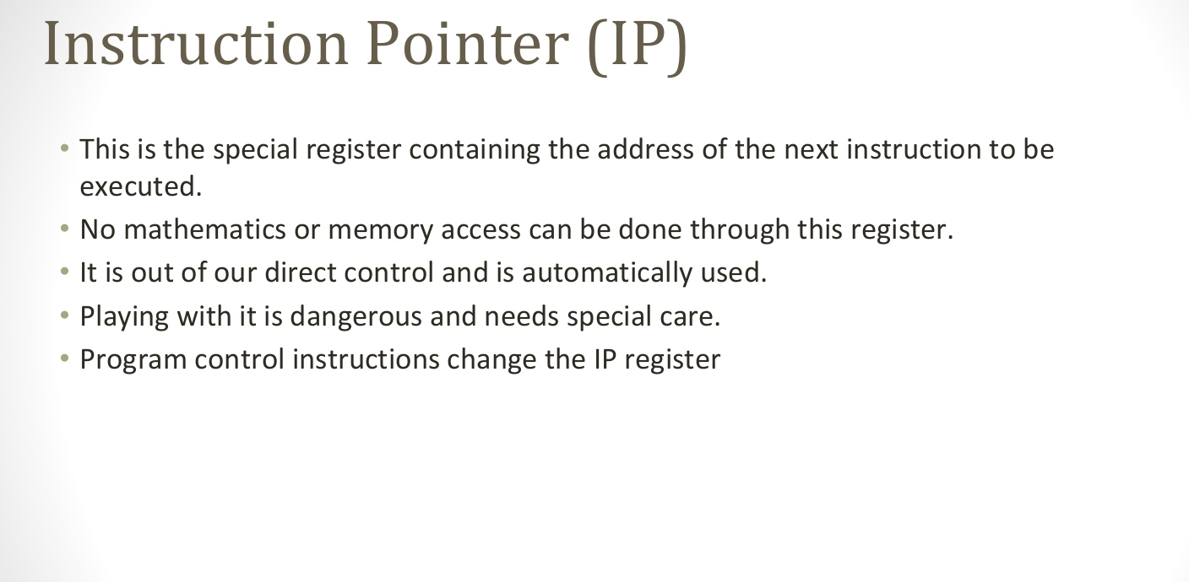
Instruction Pointer

Slide 9
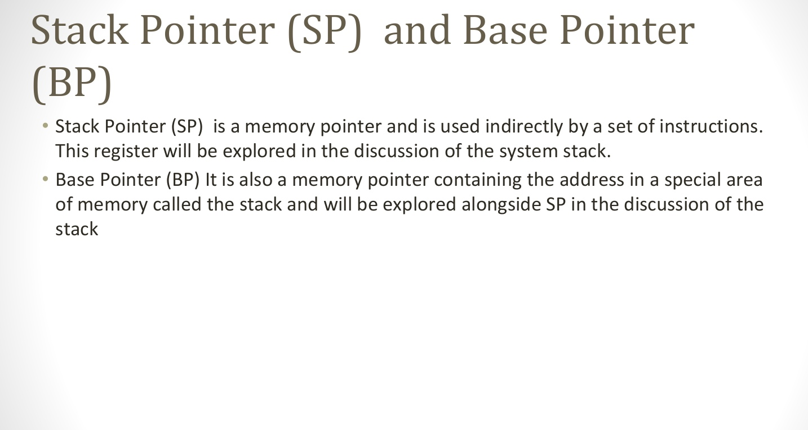
Stack and Base Pointer

Slide 10
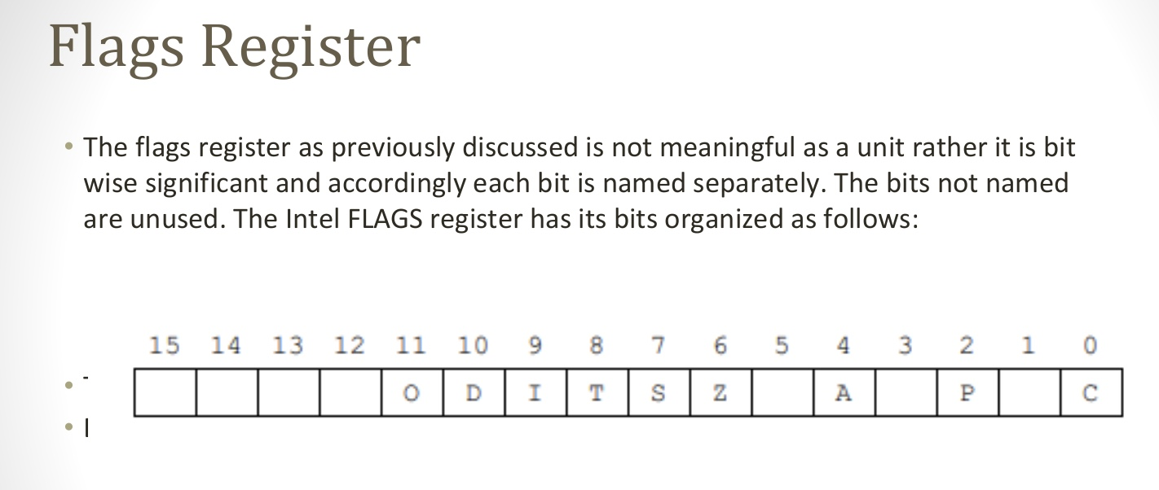
Flags

Slide 11
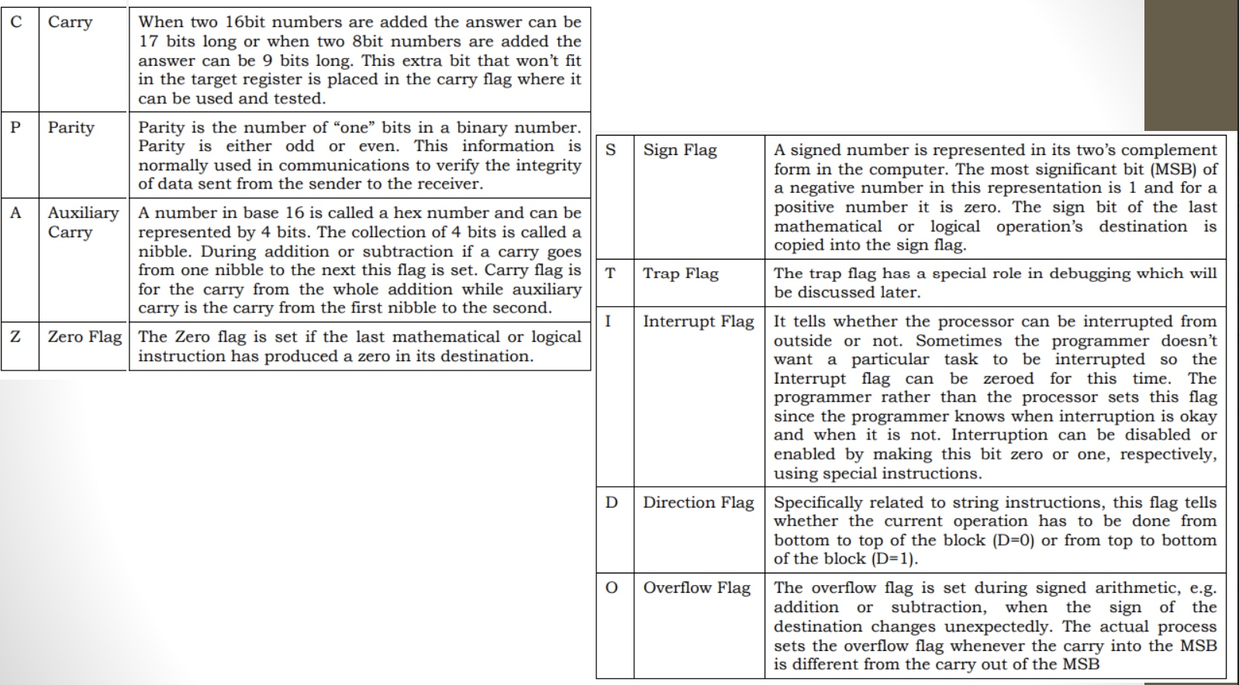
Flag Registers

Slide 12
Data Declaration
There are three ways to declare data in Assembly Language:
1.) Declare single value with label
2.) Declare Multiple values with single labels, values can be of different size
3.) Declare Mutiple values with single label, all values will be of same size

Slide 13
1.) Declare single value with label
Syntax:
<label_name>: <db/dw/dd> <value>
Example:
[org 0x0100]
; code goes here
mov ax, 0x4c00 ; termination statements
int 21h
; data declaration
num1: dw 5
num2: db 10
num3: dd 15
num4: dw 9

Slide 14
2.) Declare Multiple values with single labels, (values can be of different size )
Syntax:
<label_name>: <db/dw/dd> <value 1> <db/dw/dd> <value 2> <db/dw/dd>
<value 3> <db/dw/dd> ..... <value n>
Example:
[org 0x0100]
; code goes here
mov ax, 0x4c00 ; termination statements
int 21h
; data declaration
num1: dw 5
dw 10
db 15
dd 9

Slide 15
3.) Declare Multiple values with single labels, (all values will be of same size )
Syntax:
<label_name>: <db/dw/dd> <value1>, <value2>, …. <value n>
Example:
[org 0x0100] ;
code goes here
mov ax, 0x4c00 ; termination statements
int 21h
; data declaration
num1: dw 5, 10,15, 90

Slide 16
3.) Declare Multiple values with single labels, (all values will be of same size )
db stands for define byte,
• dw stands for define word (word is of 2 bytes)
• dd stands for define double (double is of 2 words that is 4 bytes)
• Labels are like pointer. They only have the address of the lowest byte of value. In case of multiple values declared with single label (method 3 and 4) label is the address of lowest byte of first value.

Slide 17
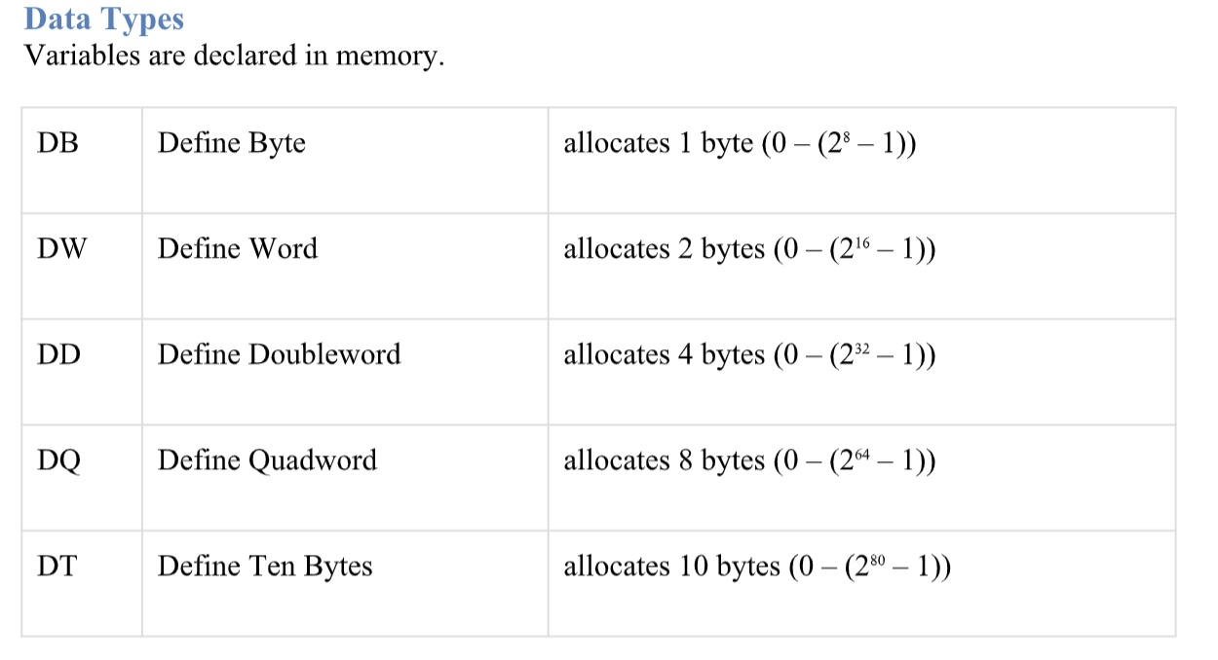
Data Types

Slide 18
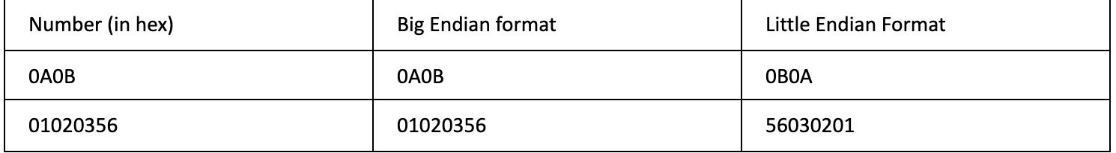
Little Endian vs Big Endian
Big endian (BE), number is written from higher BYTE to lower BYTE
Little Endian (LE), number is written from Lower BYTE to higher BYTE
Example:

Slide 19
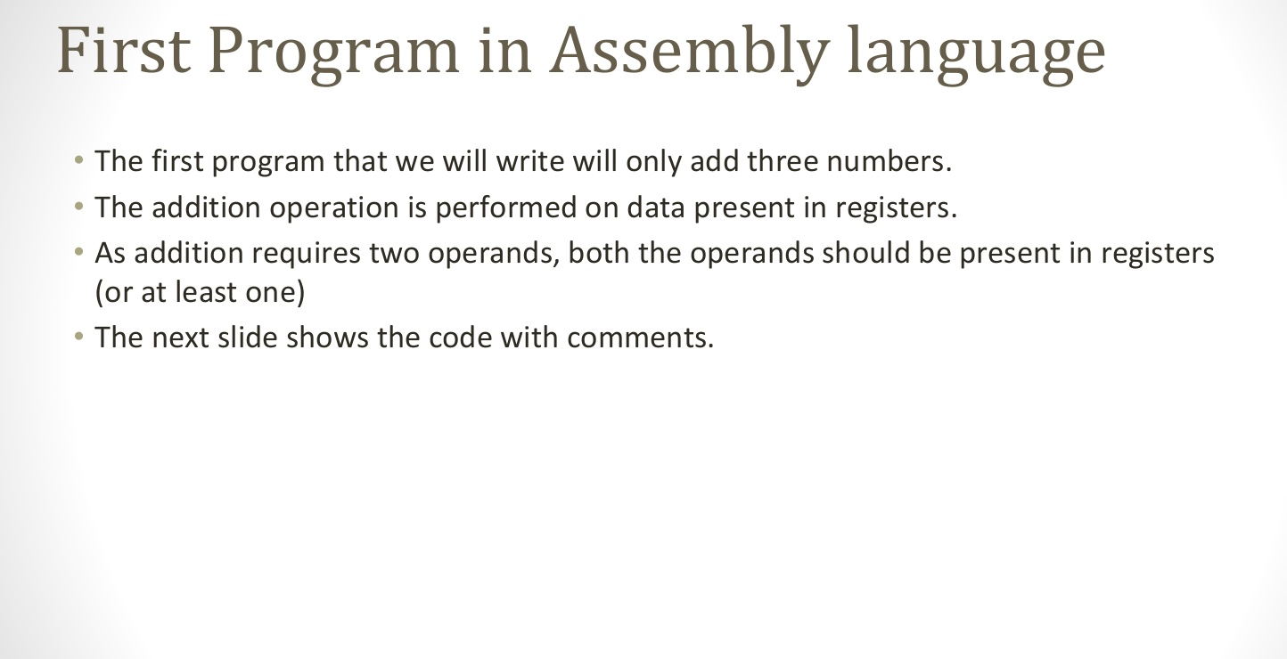
First Program

Slide 20
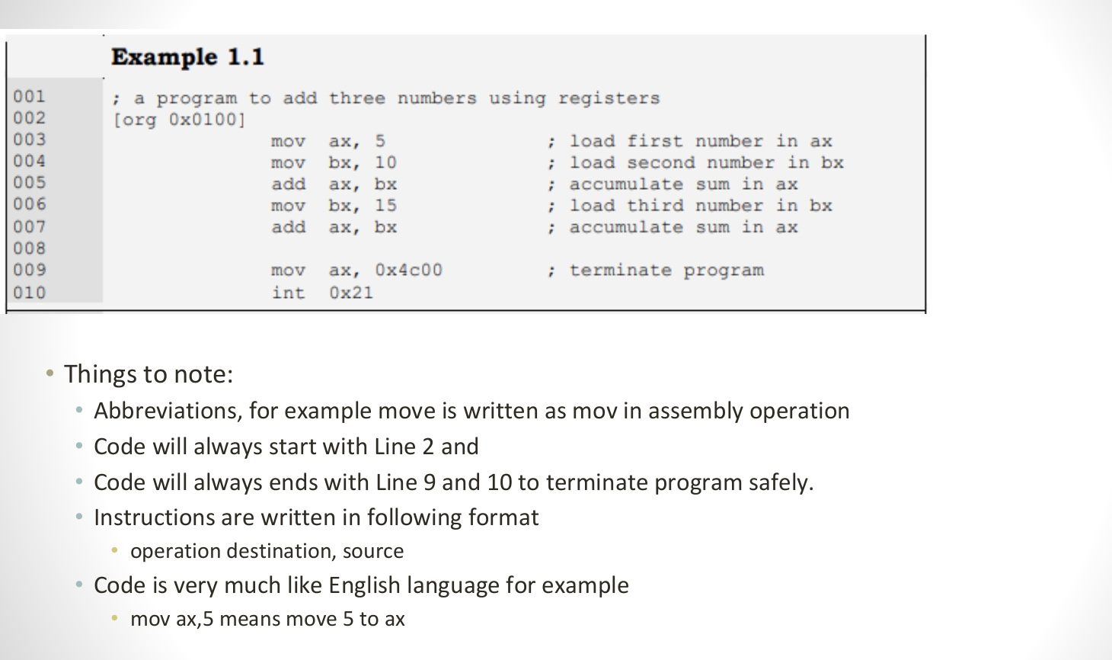
First Program

Slide 21
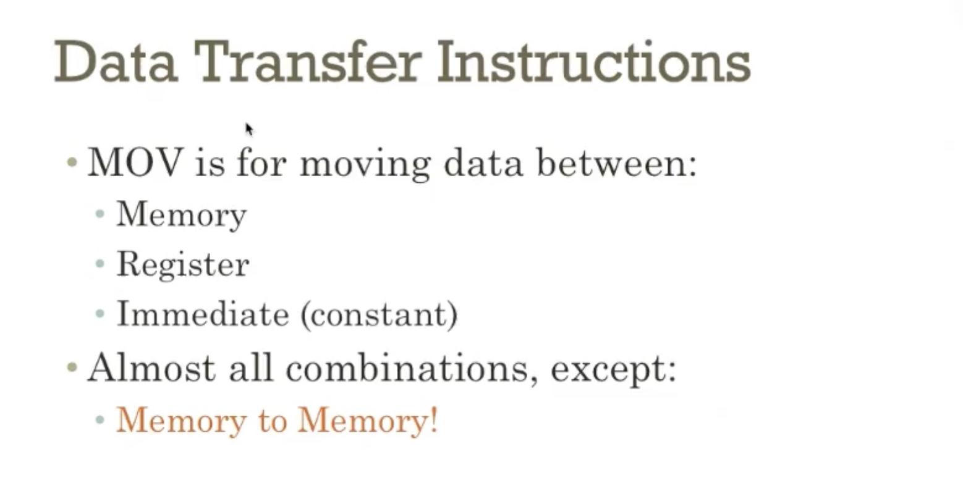

Slide 22
End of Lecture

